Slide 1


PROJECT ABOUT ICT
THE 21 CENTURY !
A century where technology was never stronger
As for information technology that started developing few centuries behind
We now witness it greatest rises ,thus it entered our lives in everyway possible
As of these ways is the
way of communications

Slide 2

WE WILL BE DEALING IN THIS PROJECT
A DEFENETION
And a peek about 3 main streams of
ICT :
THE HISTORY OF ICT
ICT FINANCIALLY
THE RULE OF ICT IN SOCIETY
TOOLS
Google services
Microsoft world
Git and github
Artifical intellegnce

Slide 3
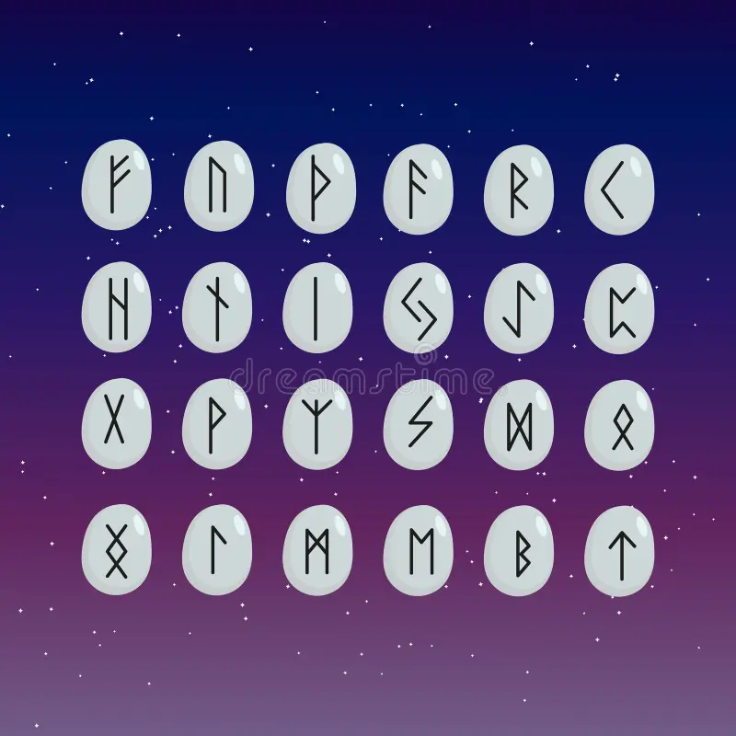

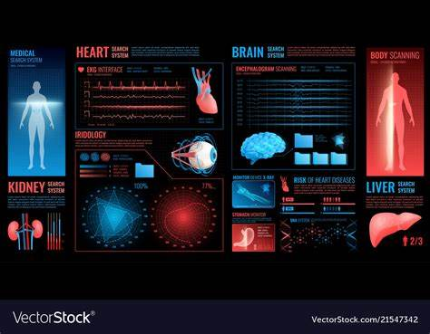

A LOOK IN HUMANITY:
ICT have helped us in our social life in every aspect possible like teaching, engaging ,news gathering ,and health systems as example the hearing bugs ,or the talking with sign language gloves ,and much more enventions that help humanity to a better communication
A LOOK IN HISTORY:
Since the dawn of history people needed communication to connect with each other ,so they used everything they could to develop this connection ,from the use of stone to crave languages ,to the paper and ink till finalyy the huge technological revelation such as radios ,phon ,laptops …
DEFENETION:
It is a broad term that encompasses the use of technology to manage and process information, as well as facilitate communication. In essence, ICT involves the convergence of telecommunications, computers, and audiovisual technologies for the purpose of information sharing and communication.
A LOOK IN FINANCE:
Communication technology have effected the finance market in both active and passive ways
Active: becauze it makes huge amount of money for both governments and interpunars
Passive: since the technological research is so expensiveit may take long years of hard work and deep pockets

Slide 4

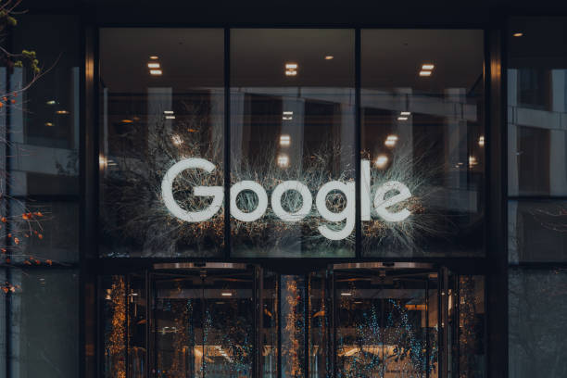
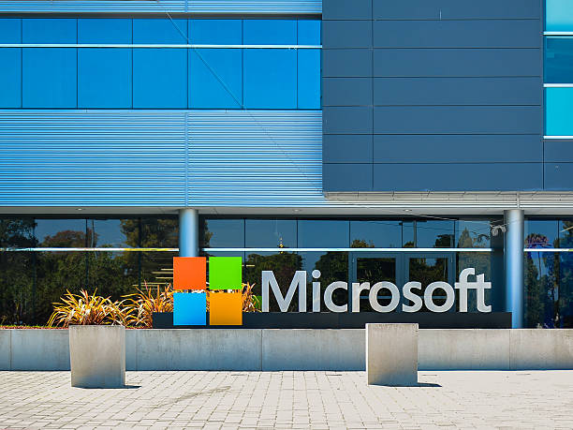
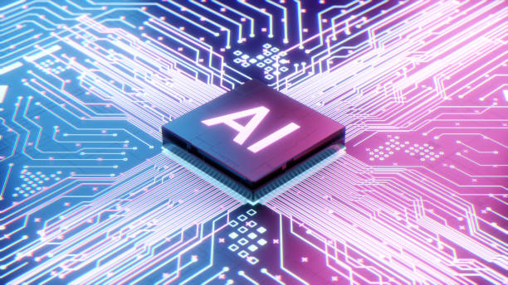





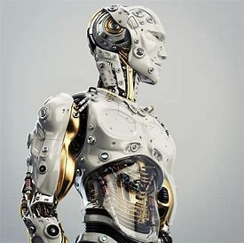
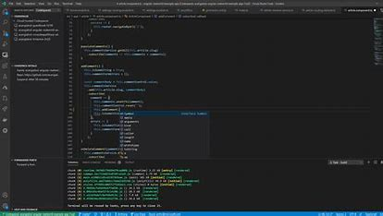




Some tools of ICT
youtube
powerpoint
excel
G.translate
hangouts
word

Slide 5
PRESENTATION : ELWAZIR MOHAMED
SECTION : C
GRP : 3

